Slide 1
C# Language Fundamentals

Slide 2
Objectives
How to write a simple program using C#?
Features of Main Function
How to pass Command Line Arguments
How to work on Multiple Mains of a Program.
Different types of variables and constants
Control flow statements
Enumerations
Arrays and different types of arrays
Console I/O
String and StringBuilder class
Programming guidelines of C#.

Slide 3
What’s C#?
C# (pronounced as See-Sharp) is a language that has been developed for building a wide range of enterprise applications that run on the .NET Framework.
Simply it is a language for building .NET based Applications.
Combines features of multiple languages and more:
RAD (Rapid Application Development) of VB
Object Oriented Feature of C++.
Elegance of Java.
Above all, supports Component Architecture.
It is a type-safe, case-sensitive language that supports all Object Oriented Programming features
Notes:
C# is a relatively new programming language and is significant in two respects:
It is specifically designed and targeted for use with Microsoft’s .NET Framework (a feature-rich platform for the development, deployment, and execution of distributed applications).
It is a language based on the modern object-oriented design methodology, and when designing it Microsoft learned from the experience of all the other similar languages that have been around since object-oriented principles came to prominence some 20 years ago.
One important thing to make clear is that C# is a language in its own right. Although it is designed to generate code that targets the .NET environment, it is not itself part of .NET. Some features are supported by .NET but not by C#, and you might be surprised to learn that some features of the C# language are not supported by .NET (for example, some instances of operator overloading)!
However, because the C# language is intended for use with .NET, it is important for you to have an understanding of this Framework if you want to develop applications in C# effectively.

Slide 4
Features of the C# Language
Pure Object Oriented Programming language.
Component Architecture.
Strict Type checking and no implicit casts.
No uninitialized variables and Safe Bound Checks.
You can overload operators of the language.
Template mechanisms through Generics.
Event based programming using delegates.
Overloads [] operator with Indexers.
Notes:
The Language has the following features:
High class architecture of Object Oriented Programming where everything is talked in terms of Classes and Objects->From your Data types to Custom Types, all are represented as objects.
Component Architecture: Your classes are units that constitute Functions (Methods) , Characteristics (Properties) and Events (Actions Performed on the Object).
C# is very powerful Language in terms of data type declarations, nothing is assumed here. Any conventions should happen specifically. Nothing is assumed.
Variables that you declare should be assigned before you use it in your Program, hence making it a perfect language for applying business rules of your Application
You can customize the operators to suit your Application requirements.
You can create Generic classes like Templates of C++.
Indexers help you to treat an object as an Array. Sounds Crazy? Think about our Training Room is an object which is having an Array of Trainees in it.

Slide 5
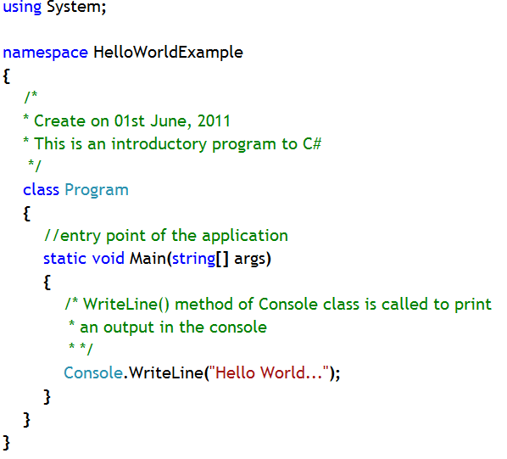
Structure of C# Program
System namespace where in-built data types are present
Namespace of the program
Multiline Comment
Program class: Every C# program should have a class to contain the entry point
Single-line Comment
Main method from where the execution starts (entry point)
Notes:
Note:
This is a simple example of the structure of a C# program. The program is being used to print a simple line in the console, using WriteLine() method.
A C# application can consist of many files. Here this is a single file application.
All in-built classes are present in different namespaces in the base class library provided by .NET Framework. WriteLine() method is an in-built method of Console class, which is present in System namespace in base class library.
Even Program class in this example belongs to a namespace ( a logical name), namely, ‘HelloWorldExample’.
In this code two types of comments have been used and they are – Single line comment and Multi line comment.
Single line comment starts with ‘//’ symbol and multi line comments starts with ‘/*’ and ends with ‘*/’. Put in your comments in this block.
The code has one entry point, namely, ‘Main’ method, from where the execution will start.

Slide 6
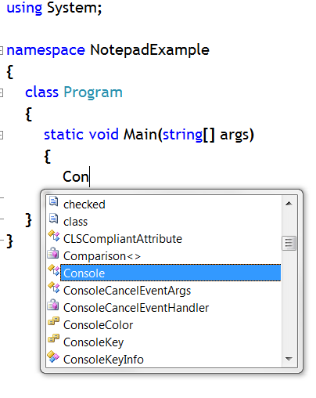
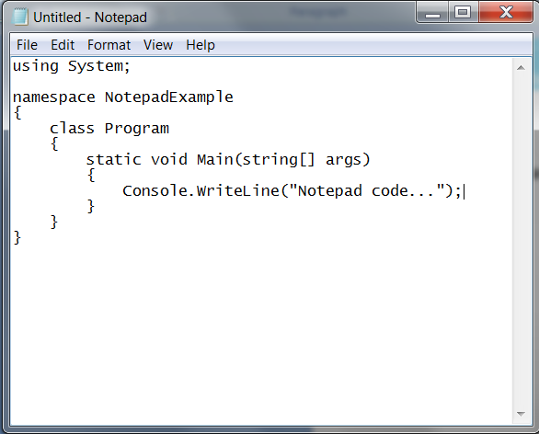
Writing Code Using Notepad and Visual Studio
Different editors can be used to write code, such as Visual Studio Editor and Notepad.
Visual Studio provides Intellisense while writing code
Notepad does not provide Intellisense while writing code

Slide 7
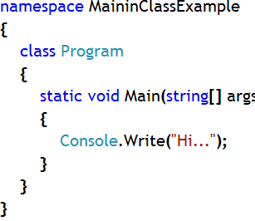
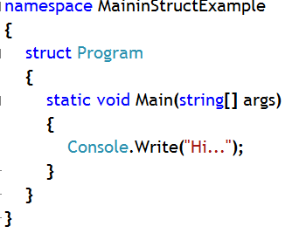
Main method
Main method is the entry point for a C# Program.
Main method is a static function defined inside a class or a structure.
Example:
Notes:
The Main method is the entry point of your program, where the program execution starts and ends.
It is declared inside a class or structure. It must be static and it need not be public. (In the example above it receives the default access of private.)
Functions in C# cannot be global. So Main is also not global function, it’s a part of either a class or structure. If so, how should the compiler call the function which is inside a class without instantiating it globally? Guess!
When made static, the function is called by the class Name, so Compiler is smart enough to pick the class which is having the entry point signature and invokes the Main function.
It can either have a void or int return type.
The Main method can be declared with or without parameters.
Parameters can be read as zero-indexed command line arguments.
Unlike C and C++, the name of the program is not treated as the first command line argument.

Slide 8
Different Signatures of Main method
Different ways to write Main method
static void Main()
static void Main(string[ ] args)
static int Main(string[ ] args)
static int Main(string[ ] args)
“args” parameter is used to take command-line parameters, i.e. values to be passed into application from outside
The return value “int” can be used to signify how the application terminates, often used as an indication of an error although this is by no means mandatory

Slide 9
Basic Input/Output - The Console Class
Console class provides access to the standard input, standard output, and standard error streams
Console has many static methods, such as Write, WriteLine for displaying output and Read, ReadLine for input from users.
Only meaningful for console applications
Standard input – keyboard
Standard output – screen
Standard error – screen
Notes:
Note:
Instance Method: Generally if you want to access any method (function) of a class, you first have to create an instance (object) of the class and then you have to access that particular method through the instance (object) of the class. This type of method is known as ‘Instance Method’.
Such as, Open(), Close() methods of SqlConnection class (this class is used to connect to SQL Server database from your application) are such examples of instance methods.
Static Method: But there are certain method(s) of a class, which are so commonly used that to access them there is no need to create any instance of that class. Those methods can be accessed directly using the class name. These methods are known as Static methods.
These methods are shared by many instances of the same class. So, static method is a shared member of a class.
Such as, Write(), WriteLine(), Read(), ReadLine(), ReadKey() methods of Console class are such examples of static methods.

Slide 10
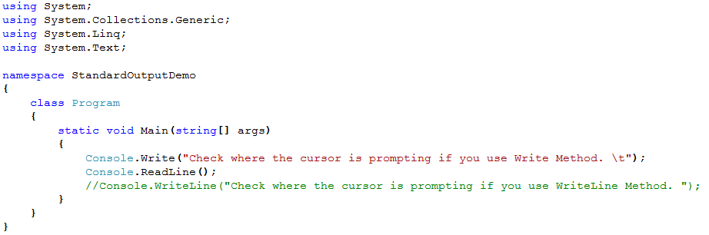
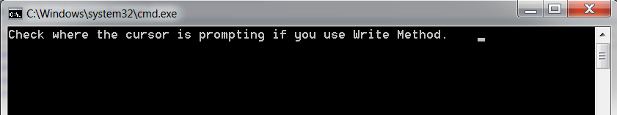
Write Method
Write() method of Console class, displays information on the console screen without a carriage return/line feed.
The method does not return anything.

Slide 11
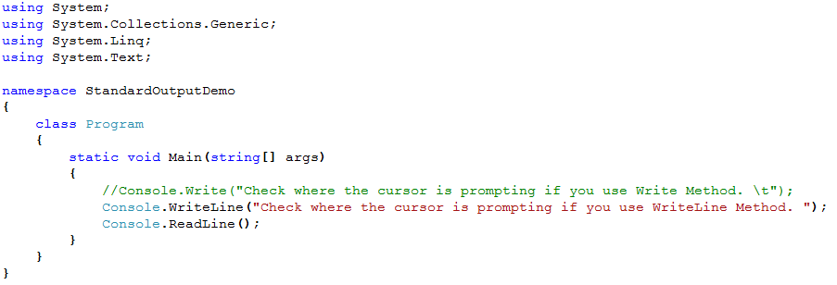
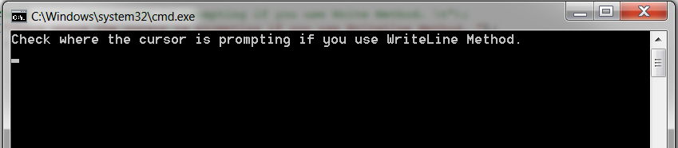
WriteLine Method
WriteLine() method of Console class, displays information on the console screen with a carriage return/line feed.
The method does not return anything.

Slide 12
Read() and ReadLine() Method
Read() method of Console class is a static method
It is used to read user input
Read() method reads the next character from the standard input stream.
Read() method does not read the entire input, reads only the first character of the entire input
This method always returns the ASCII value of only the first character of the input
ReadLine() method of Console class is also a static method
It is used to read user input
ReadLine() method reads the next line of characters from the standard input stream.
ReadLine() method reads the entire input, not only the first character of the input stream
This method always converts the entire input stream into a ‘string’ data and returns that

Slide 13
Overview of Data Type System
There are two different categories of data types. They are value and reference types
Type
Value Type
Reference Type

Slide 14
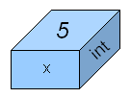
Value Type Variable
In a variable that holds a value type, the data itself is directly contained within the memory allotted to the variable
Example:
int x = 5;
The above code declares an 32-bit signed integer variable, called x, initialized with a value of 5. The following figure represents the corresponding variable diagram:
The following figure represents the corresponding variable diagram:

Slide 15
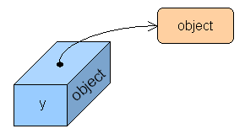
Reference Type
On the other hand, a variable that holds a reference type contains the address of an object stored in the heap.
Example:
object y = new object();
The above code declares a variable called y of type object which gets initialized, thanks to the new operator, so that it refers to a new heap allocated object instance (object is the base class of all C# types, but more of this latter).
The following figure represents the corresponding variable diagram:

Slide 16
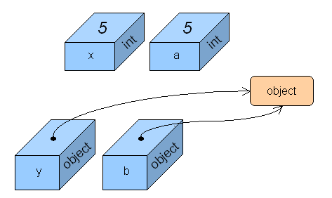
Copying Value vs. Copying Reference
Now, let us analyze what happens when we introduce two new variables and do some copying from the original variables.
Assume we have the following code:
int a = x; object b = y;
As can be observed, ‘a’ has a copy of the value of ‘x’. If we modify the value of one of these variables, the other variable would remain unchanged. In the case of ‘y’ and ‘b’, both variables refer to the same object. If we alter the state of the object using variable ‘y’, then the resulting changes will be observable using variable ‘b’, and vice versa.

Slide 17
Comparing Value and Reference Types
Value Type | Reference Type
1. Directly contain the value of a particular data type | 1. Directly does nor contain the data (object), rather contains the reference of the object
2. Two variables of same data type stores different values or copy of the same value | 2. Two variables of same data type can store reference of same object or different object
3. Operations on one variable does not affect another | 3. Operation on one variable can affect another

Slide 18
Value Types
Value Types
Built-in Type
User-Defined
Examples of built-in value types:
int
float
Examples of user-defined value types:
enum
struct

Slide 19
Built in Value Types
Type | Description | Range | Size
sbyte | Signed byte integer | - 128 to 127 | 1 byte
byte | Unsigned byte integer | 0 to 255 | 1 byte
ushort | Unsigned short integer | 0 to 65,535 | 2 byte
short | Signed short integer. | -32,768 to 32,767 | 2 byte
uint | Unsigned integer. Examples: 26U, 0x1AU (mandatory U suffix) | 0 to 4294967295 | 4 byte
Int | Signed integer. Literals may be in decimal (default) or hexadecimal notation (with an 0x prefix). Examples: 26, 0x1A | -2147483648 to 2147483647 | 4 byte
ulong | Unsigned long integer. Examples: 26UL, 0x1AUL (mandatory UL suffix) | 0 to 2 to the power 64 | 8 byte

Slide 20
Built in Value Types
Type | Description | Range | Size
long | Signed long integer. Examples: 26L, 0x1AL (mandatory L suffix) | (- 2to the power 63) to (2 to the power 63) -1 | 8 byte
float | IEEE 754 single precision floating point number. Examples: 1.2F, 1E10F (mandatory F suffix) | 1.5*10^-45 to 3.4*10^38 | 4 byte
double | IEEE 754 double precision floating point number. Examples: 1.2, 1E10, 1D (optional D suffix) | 5.0*10^-324 to 1.7*1o^308 | 8 byte
decimal | Numeric data type suitable for financial and monetary calculations, exact to the 28th decimal place. Example: 123.45M (mandatory M suffix) | 1.0*10^-28 to 1.0*10^28 | 16 byte
char | Unicode character. Example: 'A' (contained within single quotes) | 0 to 65,535 | stored as integer between 0 to 65535
bool | Boolean value. The only valid literals are true and false. | -2147483648 to 2147483647 | True or False

Slide 21
Rules and Recommendations for Naming Variables
Rules
Use letters, the underscore, and digits
Recommendations
Avoid using all uppercase letters
Avoid starting with an underscore
Avoid using abbreviations
Use PascalCasing naming in multiple-word names
✓
Answer42
42Answer
✗
✓
different Different
✓
✗
BADSTYLE
_poorstyle
BestStyle
✗
✓
✗
Msg
Message
✓

Slide 22
C# Keywords
Keywords are reserved identifiers
Do not use keywords as variable names
Results in a compile-time error
Avoid using keywords by changing their case sensitivity
abstract, base, bool, default, if, finally
int INT; // Poor style

Slide 23
Declaring Local Variables
Usually declared by data type and variable name:
Possible to declare multiple variables in one declaration:
--or--
int itemCount;
int itemCount, employeeNumber;
int itemCount,
employeeNumber;

Slide 24
Assigning Values to Variables
Assign values to variables that are already declared:
Initialize a variable when you declare it:
You can also initialize character values:
int employeeNumber;
employeeNumber = 23;
int employeeNumber = 23;
char middleInitial = 'J';

Slide 25
Compound Assignment
Adding a value to a variable is very common
There is a convenient shorthand
This shorthand works for all arithmetic operators
itemCount = itemCount + 40;
itemCount += 40;
itemCount -= 24;

Slide 26
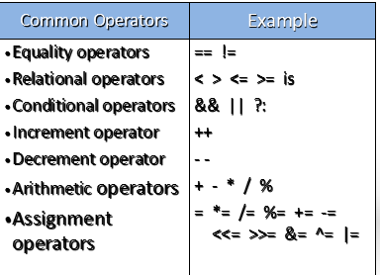
Common Operators

Slide 27
Increment and Decrement
Changing a value by one is very common
There is a convenient shorthand
This shorthand exists in two forms
itemCount += 1;
itemCount -= 1;
itemCount++;
itemCount--;
++itemCount;
--itemCount;

Slide 28
Operator Precedence
Operator Precedence and Associativity
Except for assignment operators, all binary operators are left-associative
Assignment operators and conditional operators are right-associative

Slide 29
Converting Data Types
Implicit Data Type Conversion
Explicit Data Type Conversion

Slide 30
Implicit Data Type Conversion
Converting lower range value into higher range value
Example:
Implicit conversions cannot fail
May lose precision, but not magnitude
using System;
class Test
{
static void Main( )
{
int intValue = 123;
long longValue = intValue;
Console.WriteLine("(long) {0} = {1}", intValue, longValue);
}
}

Slide 31
Explicit Data Type Conversion
Converting higher range value into lower range value
Either, you have to use Cast operator to do that job
Or, you have to methods of Convert class to do that job
Example:
using System;
class Test
{
static void Main( )
{
long longValue = 1234567890;
int intValue = (int) longValue;
Console.WriteLine("(int) {0} = {1}", longValue, intValue);
}
}

Slide 32
Using Convert Class
Convert class contains methods to convert any data type into target data type
Can be used for both Implicit and Explicit conversion
Belongs to System namespace
Example:
User is asked to enter his/her id
ReadLine() method returns id in string format
ToInt32 method of Convert class is being used to convert that string representation into integer representation
static void Main()
{
Console.Write(“Enter Your Identification Number: “);
string strId = Console.ReadLine();
int intId = convert.ToInt32(strId);
}
Notes:
ToInt32() method converts any data type into ‘int’ data type.
Similarly, all other methods like, ToDecimal(), ToDouble() etc are used to convert any data type into ‘decimal’, ‘double’ data type respectively

Slide 33
Using Parse Method
Parse is used to convert only string data type into some other data type
Example:
Controls that accept user input, such as TextBox, do so in the form of a string.
The Parse method can be used to convert that string to usable data.
In all implementations, Parse is a static (Shared) method and must be called from the type object rather than from an instance.
Code Example:
int intValue;
string strValue;
strValue = "1234";
intValue = int.Parse(S);

Slide 34
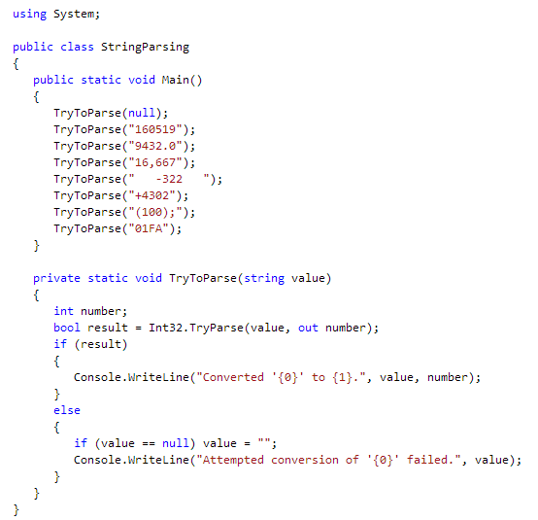
Using TryParse method
Converts the string representation of a number to its 32-bit signed integer equivalent. A return value indicates whether the conver
The TryParse method is like the Parse method, except the TryParse method does not throw an exception if the conversion fails. It eliminates the need to use exception handling to test for a FormatException in the event that s is invalid and cannot be successfully parsed.
Notes:
// The example displays the following output to the console:
// Attempted conversion of '' failed.
// Converted '160519' to 160519.
// Attempted conversion of '9432.0' failed.
// Attempted conversion of '16,667' failed.
// Converted ' -322 ' to -322.
// Converted '+4302' to 4302.
// Attempted conversion of '(100);' failed.
// Attempted conversion of '01FA' failed.

Slide 35
Statements in C#
Category | C# keywords
Selection statements | if, else, switch, case
Iteration statements | do, for, foreach, in, while
Jump statements | break, continue, default, goto, return, yield
Exception handling statements | throw, try-catch, try-finally, try-catch-finally
Checked and unchecked | checked, unchecked
fixed Statement | fixed
lock Statement | lock

Slide 36
If..Else Statement
Syntax:
No implicit conversion from int to bool
if ( Boolean-expression )
first-embedded-statement
else
second-embedded-statement
int x;
...
if (x) ... // Must be if (x != 0) in C#
if (x = 0) ... // Must be if (x == 0) in C#

Slide 37
Cascading if Statements
Console,WriteLine(“Enter Color Choice: “);
string choice = Console.ReadLine();
if (choice == “Black”)
Console.WriteLine(“Choice is Black..”);
else if (choice == “Blue”)
Console.WriteLine(“Choice is Blue..”);
else if (choice == “Red”)
Console.WriteLine(“Choice is Red..”);
else
Console.WriteLine(“No Color choice..”);

Slide 38
The switch Statement
Use switch statements for multiple case blocks
Use break statements to ensure that no fall through occurs
switch (choice)
{
case “Black”:
Console.WriteLine(“Choice is Black..”);
break;
case “Blue”:
Console.WriteLine(“Choice is Blue..”);
break;
case “Red”:
Console.WriteLine(“Choice is Red..”);
default:
Console.WriteLine(“No Color choice..”);
break;
}

Slide 39
The while Statement
Execute embedded statements based on Boolean value
Evaluate Boolean expression at beginning of loop
Execute embedded statements while Boolean value Is True
int i = 0;
while (i < 10)
{
Console.WriteLine(i);
i++;
}
0 1 2 3 4 5 6 7 8 9

Slide 40
The do Statement
Execute embedded statements based on Boolean value
Evaluate Boolean expression at end of loop
Execute embedded statements while Boolean value Is True
int i = 0;
do {
Console.WriteLine(i);
i++;
} while (i < 10);
0 1 2 3 4 5 6 7 8 9

Slide 41
The for Statement
Place update information at the start of the loop
Variables in a for block are scoped only within the block
A for loop can iterate over several values
for (int i = 0; i < 10; i++)
{
Console.WriteLine(i);
}
0 1 2 3 4 5 6 7 8 9
for (int i = 0; i < 10; i++)
Console.WriteLine(i);
Console.WriteLine(i); // Error: i is no longer in scope
for (int i = 0, j = 0; ... ; i++, j++)

Slide 42
The foreach Statement
Choose the type and name of the iteration variable
Execute embedded statements for each element of the collection class
ArrayList numbers = new ArrayList( );
for (int i = 0; i < 10; i++ )
{
numbers.Add(i);
}
foreach (int number in numbers)
{
Console.WriteLine(number);
}
0 1 2 3 4 5 6 7 8 9

Slide 43
The goto Statement
Flow of control transferred to a labeled statement
Can easily result in obscure “spaghetti” code
if (number % 2 == 0) goto Even;
Console.WriteLine("odd");
goto End;
Even:
Console.WriteLine("even");
End:;

Slide 44
The break and continue Statements
The break statement jumps out of an iteration
The continue statement jumps to the next iteration
int i = 0;
while (true)
{
Console.WriteLine(i);
i++;
if (i < 10)
continue;
else
break;
}

Slide 45
Defining Methods
Main is a method
Use the same syntax for defining your own methods
using System;
class ExampleClass
{
static void ExampleMethod( )
{
Console.WriteLine("Example method");
}
static void Main( )
{
// ...
}
}

Slide 46
Calling Methods
After you define a method, you can:
Call a method from within the same class
Use method’s name followed by a parameter list in parentheses
Call a method that is in a different class
You must indicate to the compiler which class contains the method to call
The called method must be declared with the public keyword
Use nested calls
Methods can call methods, which can call other methods, and so on

Slide 47
Using the return Statement
Immediate return
Return with a conditional statement
static void ExampleMethod( )
{
int numBeans;
//...
Console.WriteLine("Hello");
if (numBeans < 10)
return;
Console.WriteLine("World");
}

Slide 48
Scope of Variables
Local variables
Created when method begins
Private to the method
Destroyed on exit
Shared variables
Class variables are used for sharing
Scope conflicts
Compiler will not warn if local and class names clash

Slide 49
Statement Blocks
Use braces As block delimiters
A block and its parent block cannot have a variable with the same name
Sibling blocks can have variables with the same name
{
// code
}
{
int i;
...
{
int i;
...
}
}
{
int i;
...
}
...
{
int i;
...
}

Slide 50
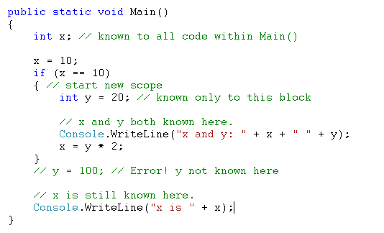
Scope of the Variable
A field of a class is in scope as long as its containing class is in scope
A local variable is in scope until a closing brace indicates the end of block statement in which its declared.
A local variable that is declared in for, while or similar statement is in scope in the body of that loop.

Slide 51
Returning Values from Methods
Declare the method with non-void type
Add a return statement with an expression
Sets the return value
Returns to caller
Non-void methods must return a value
static int TwoPlusTwo( ) {
int a,b;
a = 2;
b = 2;
return a + b;
}
int x;
x = TwoPlusTwo( );
Console.WriteLine(x);

Slide 52
Declaring and Calling Parameters
Declaring parameters
Place between parentheses after method name
Define type and name for each parameter
Calling methods with parameters
Supply a value for each parameter
static void MethodWithParameters(int n, string y)
{ ... }
MethodWithParameters(2, "Hello, world");

Slide 53
Mechanisms for Passing Parameters
Three ways to pass parameters
in
Pass by value
in
out
Pass by reference
out
Output parameters

Slide 54
Pass by Value
static void AddOne(int x)
{
x++; // Increment x
}
static void Main( )
{
int k = 6;
AddOne(k);
Console.WriteLine(k);
// Displays the value 6, not 7
}
Default mechanism for passing parameters:
Parameter value is copied
Variable can be changed inside the method
Has no effect on value outside the method
Parameter must be of the same type or compatible type

Slide 55
Pass by Reference
static void AddOne(ref int x)
{
x++; // Increment x
}
static void Main( )
{
int k = 6;
AddOne(ref k);
Console.WriteLine(k);
// Displays the value 7
}
What are reference parameters?
A reference to memory location
Using reference parameters
Use the ref keyword in method declaration and call
Match types and variable values
Changes made in the method affect the caller
Assign parameter value before calling the method

Slide 56
Output Parameters
What are output parameters?
Values are passed out but not in
Using output parameters
Like ref, but values are not passed into the method
Use out keyword in method declaration and call
static void AddOne(out int x)
{
X=6; //first assign value
x++; // Increment x
}
static void Main( )
{
int k; //no need to assign
AddOne(out k);
Console.WriteLine(k);
// Displays the value 7
}

Slide 57
Guidelines for Passing Parameters
Mechanisms
Pass by value is most common
Method return value is useful for single values
Use ref and/or out for multiple return values
Only use ref if data is transferred both ways
Efficiency
Pass by value is generally the most efficient

Slide 58
Array
An array is a data structure that contains several items of the same type.
Arrays are zero indexed: an array with n elements is indexed from 0 to n-1.
When declaring an array, the square brackets ([]) must come after the type, not the identifier.
Array types are reference types derived from the abstract base type Array. Since this type implements IEnumerable and IEnumerable<T>, you can use foreach iteration on all arrays in C#.
Integer index 0
(zero)
Integer index 4
(four)
Notes:
Notes:
An array has the following properties:
An array can be Single-Dimensional, Multidimensional or Jagged.
The default value of numeric array elements are set to zero, and reference elements are set to null.
A jagged array is an array of arrays, and therefore its elements are reference types and are initialized to null.
Array elements can be of any type, including an array type.

Slide 59
Array Notation in C#
You declare an array variable by specifying:
The element type of the array
The rank of the array
The name of the variable
type[ ] name;
This specifies the name of the array variable
This specifies the rank of the array
This specifies the element type of the array

Slide 60
Array Rank
Rank is also known as the array dimension
The number of indexes associated with each element
long[ ] row;
int[,] grid;
Rank 1: One-dimensional
Single index associates with each long element
Rank 2: Two-dimensional
Two indexes associate with each int element

Slide 61
Accessing Array Elements
Supply an integer index for each rank
Indexes are zero-based
long[ ] row;
...
row[3];
int[,] grid;
...
grid[1,2];
2
3
1

Slide 62
Checking Array Bounds
All array access attempts are bounds checked
A bad index throws an IndexOutOfRangeException
Use the Length property and the GetLength method
row
grid
grid.GetLength(0)==2
row.GetLength(0)==6
grid.GetLength(1)==4
row.Length==6
grid.Length==2*4

Slide 63
Creating Array Instances
Declaring an array variable does not create an array!
You must use new to explicitly create the array instance
Array elements have an implicit default value of zero
row
long[ ] row = new long[4];
0
0
0
0
Variable
Instance
int[,] grid = new int[2,3];
0
0
0
grid
0
0
0

Slide 64
Initializing Array Elements
The elements of an array can be explicitly initialized
You can use a convenient shorthand
long[ ] row = new long[4] {0, 1, 2, 3};
long[ ] row = {0, 1, 2, 3};
Equivalent
0
1
2
3
row

Slide 65
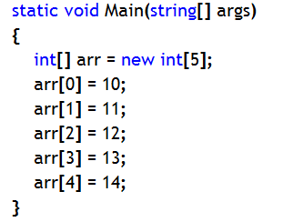
Single dimensional Array
Array containing a single row of values
Example:
int[] numbers = new int[5] {1, 2, 3, 4, 5};
string[] names = new string[3] {"Matt", "Joanne", "Robert"};
100XDF
0
10
1
11
arr
2
12
3
13
4
14
Stack
Heap
Notes:
Different type of single-dimensional array declaration and initialization:
1. Example: int[] numbers = new int[4];
numbers[0]=1; numbers[1]=2; numbers[2]=3; numbers[3]=4;
2. Example: int[] numbers = new int[] {1,2,3,4};
3. Example: int[] numbers = {1,2,3,4};

Slide 66
Initializing Multidimensional Array Elements
Array containing multiple rows with same number of items for each row.
You can also initialize multidimensional array elements
All elements must be specified
int[,] grid = {
{5, 4, 3},
{2, 1, 0}
};
Implicitly a new int[2,3] array
✓
5
4
3
grid
2
1
0
int[,] grid = {
{5, 4, 3},
{2, 1 }
};
✗

Slide 67
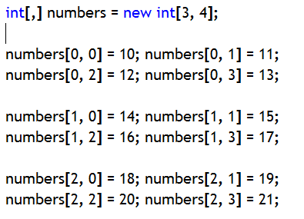
Example:
100XDF
0
10
11
12
13
1
14
15
16
17
arr
2
18
19
20
21
Stack
Heap
Notes:
Different type of multi-dimensional array declaration and initialization:
1. Example: string[,] persondetails= new string[2,3];
persondetails[0,0]=“Mahesh”; persondetails[0,1]=“TTG”; persondetails[1,0]=“Pramod”; persondetails[1,1]=“CC”;
2. Example: string[,] persondetails = new string[,] { { "Mahesh", "TTG" },{"Pramod","CC"} };
3. string[,] persondetails = { { "Mahesh", "TTG" }, { "Pramod", "CC" } };

Slide 68
Creating a Computed Size Array
The array size does not need to be a compile-time constant
Any valid integer expression will work
Accessing elements is equally fast in all cases
Array size specified by compile-time integer constant:
Array size specified by run-time integer value:
long[ ] row = new long[4];
string s = Console.ReadLine();
int size = int.Parse(s);
long[ ] row = new long[size];

Slide 69
Copying Array Variables
Copying an array variable copies the array variable only
It does not copy the array instance
Two array variables can refer to the same array instance
long[ ] row = new long[4];
long[ ] copy = row;
...
row[0]++;
long value = copy[0];
Console.WriteLine(value);
0
0
0
0
row
copy
Variable
Instance

Slide 70
Array Class Properties
Some Important Properties:
Length and Rank
long[ ] row = new long[4];
row.Rank
1
0
0
0
0
row.Length
4
row
int[,] grid = new int[2,3];
grid.Rank
2
0
0
0
grid.Length
6
grid
0
0
0

Slide 71
Array Class Methods
System.Array class: Provides methods for creating, manipulating, searching, and sorting arrays, thereby serving as the base class for all arrays in the common language runtime.
Commonly used methods
Clear: Sets a range of elements to zero or null
Clone: Creates a copy of the array
Copy: It is a static method. Copies the Array with data to another array. The method returns nothing.
CopyTo: Copies the Data only to another Array. The method returns nothing.
CreateInstance: It is a static method Allows to create an Instance of a new Array. This function is used to create Arrays using System.Array class. (To Create Arrays Dynamically).
GetLength: Returns the length of a given dimension
IndexOf: Returns the index of the first occurrence of a value
Sort: Sorts the elements in an array of rank 1

Slide 72
Returning Arrays from Methods
You can declare methods to return arrays
class Example {
static void Main( ) { int[ ] array = CreateArray(42);
...
} static int[ ] CreateArray(int size) { int[ ] created = new int[size];
return created; }
}

Slide 73
Passing Arrays as Parameters
An array parameter is a copy of the array variable
Not a copy of the array instance
class Example2 {
static void Main( ) { int[ ] arg = {10, 9, 8, 7}; Method(arg); System.Console.WriteLine(arg[0]); } static void Method(int[ ] parameter) { parameter[0]++; }
}
This method will modify the original array instance created in Main

Slide 74
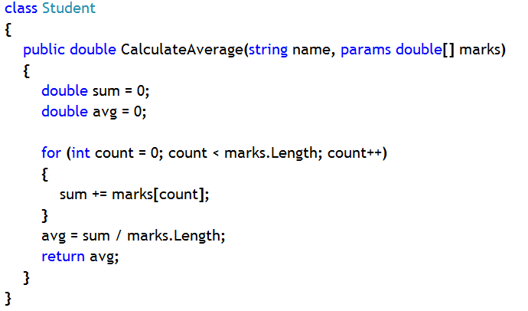
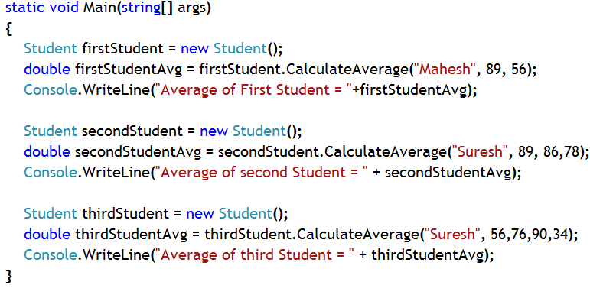
‘params’ keyword and Param Array
‘params’ keyword is used with an array declaration provided the array is part of the method argument
This enables the array to accept values directly that is passed to the method directly when the method is called
While passing parameter during a method call, if the caller is not sure about how many parameters to pass then the method should possess a param array to accept unknown number of arguments
Notes:
Notes:
Only an array declared as part of the method argument list can be declared with ‘params’ keyword
The array is known as Param Array (an array which directly accepts values as parameter rather a reference to an array)
Only one param array is possible to be declared as part of the method argument list
Any known argument should be passed to the method first and then all the unknown number of arguments should be passed to the param array of the method argument list
Consequentially, the method should have known number arguments first and then param array should be the last in the argument list

Slide 75
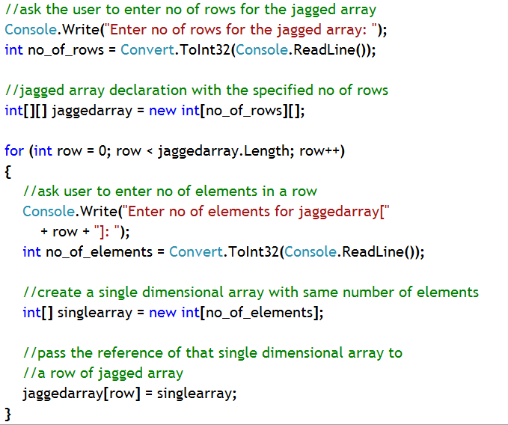
Jagged Array
It is an array of arrays
It is an array containing multiple rows, but each with different number of elements
DataTable class, used in ADO.NET contains a jagged array to store multiple records, where each record might have different number of attributes (columns)
102FG34
10
11
13
14
100XDF
0
1
106YT3G
15
16
jaggedarray
Single dimensional arrays
2
109IYJ7
17
18
19
3
230HJ67
20
4
4569YTK
21
22
23
24
25
Stack
Heap
Notes:
Note: Jagged array could be an array of single or multi dimensional arrays as well as even jagged arrays, too.

Slide 76
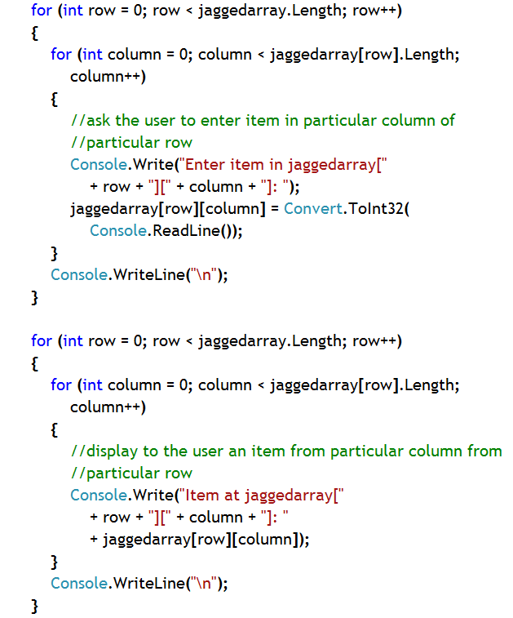
Entering Items Into and Displaying Items From Jagged Array

Slide 77
Enumerations
The enum keyword is used to declare an enumeration, a user defined type consisting of a set of named constants called enumerator list.
Every enumeration member value has an underlying type, which can be any integral type numerical value such as short, ushort, byte, sbyte, int, uint, long, ulong but can’t be of type char, double, decimal, float, bool, string etc.The default underlying data type of the enumeration member value is int.
Enumeration is useful when you have to supply some predefined set of values, such as designation of employees in an organization or set of colors for the background of a Windows or Web Form
Notes:
Note:
Examples:
public enum days{ SunDay, MonDay, TuesDay, WednesDay, ThursDay, FriDay, SaturDay};
public enum days{ sun=1, Mon, tue, wed, thu, fri, sat};
public enum days:long { sun, Mon, tue,wed,thu,fri,sat};

Slide 78
Using Enumeration
Defining an Enumeration Type
Using an Enumeration Type
Displaying an Enumeration Variable
Displaying an Enumeration Variable’s hidden value
enum Color { Red, Green, Blue }
Color colorPalette = Color.Red;
Console.WriteLine(“{0}”, colorPalette); // Displays Red
Console.WriteLine(“{0}”, Convert.ToInt32( colorPalette));
// Displays hidden numerical value of member Red

Slide 79
Using Enumeration in other Data Types
Enumeration can be used as a member in another data type, such as a class
Consider an organization, where each and every employee has a designation, whether it is software engineer or project manager etc.
An organization as a set of designation, which can’t be supplied as outside value
Use enumeration to encapsulate the designations and then use any value from that to assign designation of an employee

Slide 80
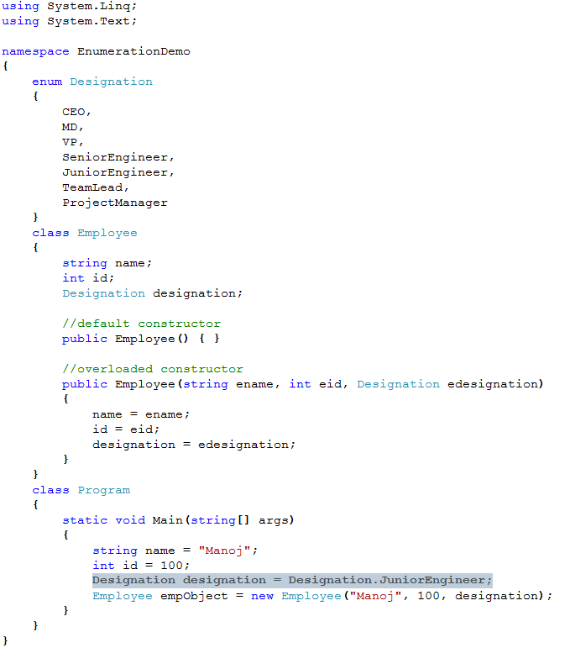
Example: Using Enumeration in a Data Type, such as Class

Slide 81
System.Enum Class
Provides the base class for enumerations.
Provides static methods for different purpose
Such as,
Format() method
GetValues() method
Parse() method

Slide 82
System.Enum class methods
Format() method
Signature:
public static string Format(System.Type enumType, object value, string format)
Converts the specified value of a specified enumerated type to its equivalent string representation according to the specified format.
Parameters:
enumType: The enumeration type of the value to convert.
value: The value to convert.
format: The output format to use.
Returns:
A string representation of value

Slide 83
System.Enum Class Methods
GetValues() Method
Signature:
public static System.Array GetValues(System.Type enumType)
Retrieves an array of the values of the constants in a specified enumeration.
Parameters:
enumType: An enumeration type.
Returns:
An System.Array of the values of the constants in enumType. The elements of the array are sorted by the binary values of the enumeration constants.

Slide 84
System.Enum Class Methods
Parse() Method: There are two overloaded versions
Signature:
public static object Parse(System.Type enumType, string value, bool ignoreCase)
Converts the string representation of the name or numeric value of one or more enumerated constants to an equivalent enumerated object. A parameter specifies whether the operation is case-sensitive.
Parameters:
enumType: The System.Type of the enumeration.
value: A string containing the name or value to convert.
ignoreCase: If true, ignore case; otherwise, regard case.
Returns:
An object of type enumType whose value is represented by value.

Slide 85
System.Enum
Parse() Method
Signature:
public static object Parse(System.Type enumType, string value)
Converts the string representation of the name or numeric value of one or more enumerated constants to an equivalent enumerated object.
Parameters:
enumType: The System.Type of the enumeration.
value: A string containing the name or value to convert.
Returns:
An object of type enumType whose value is represented by value.

Slide 86
Some Important Points To Remember About Enum
First member of any enumeration has default value 0, if not assigned anything else
Values for next members get incremented by 1 automatically
You can assign value to first member and remaining members gets their values automatically, incremented by 1.
You can assign distinct values to each and every member, too
enum Color { Red, Green, Blue } //Red=0, Green=1, Blue=2
enum Color { Red = 100, Green, Blue } //Green=101,Blue=102
enum Color { Red = 100, Green = 200, Blue = 300 }

Slide 87
Strings in C#
A string is a sequence of characters.
Unlike most of the other languages, .NET treats a string as a single value rather than as an array of characters.
The String objects are immutable, i.e., once an object of the String class is created, the string it contains cannot be changed.
The String Constructors
The String class supports several constructors. To create an empty String, you call the default constructor.
For example: String s = new String();
To create a String initialized by an array of characters, use the constructor shown here:
String(char chars[ ])
For example:
char chars[ ] = { 'a', 'b', 'c' };
String s = new String(chars);

Slide 88
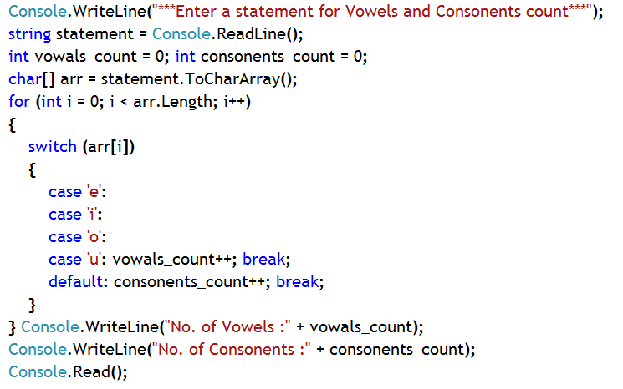
Strings in C#
Strings are objects in .NET Framework; therefore represented through System.String class.
It also has keyword representation string (blue colored) which is said to be an alias for System.String
The string type represents a string of Unicode characters.
A string is a reference type.
String Literals
You can use a string literal to initialize a String object
String s2 = “MindTree Ltd"; // use string literal
100XDF
M
I
N
D
statemenet
0
1
2
3
Stack
Heap

Slide 89
String Length and String Comparison
String Length: Use property ‘Length’of String class.
string s = “MindTree”;
System.Console.WriteLine( s.Length () ) ; // 8
String Comparison: To compare between two strings you can use
public static int Compare(string strA, string strB);: Compares two specified System.String objects
Returns:
A 32-bit signed integer indicating the lexical relationship between the two comparands.
If the return value is less than zero, then strA is less than strB.
If the return value is equal zero, then strA equals strB.
If the return value is greater than zero, then strA is greater than strB.
There are many more overloaded versions of compare method.

Slide 90
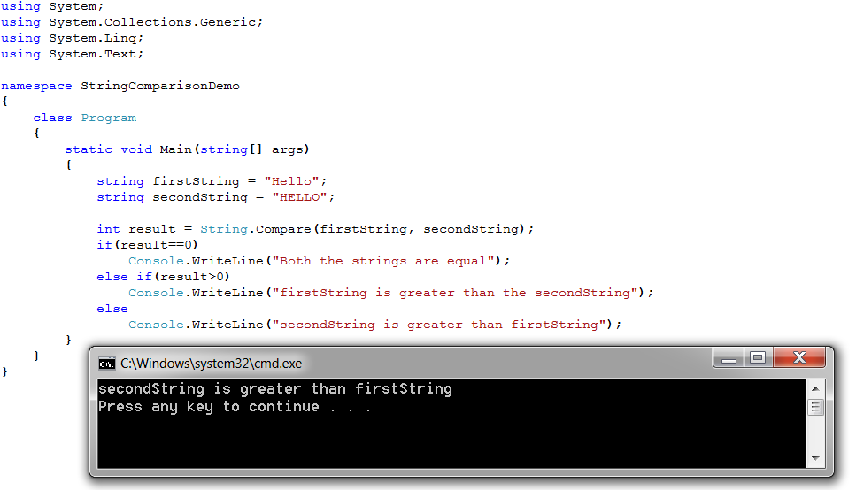
String Comparison using Compare Method Example

Slide 91
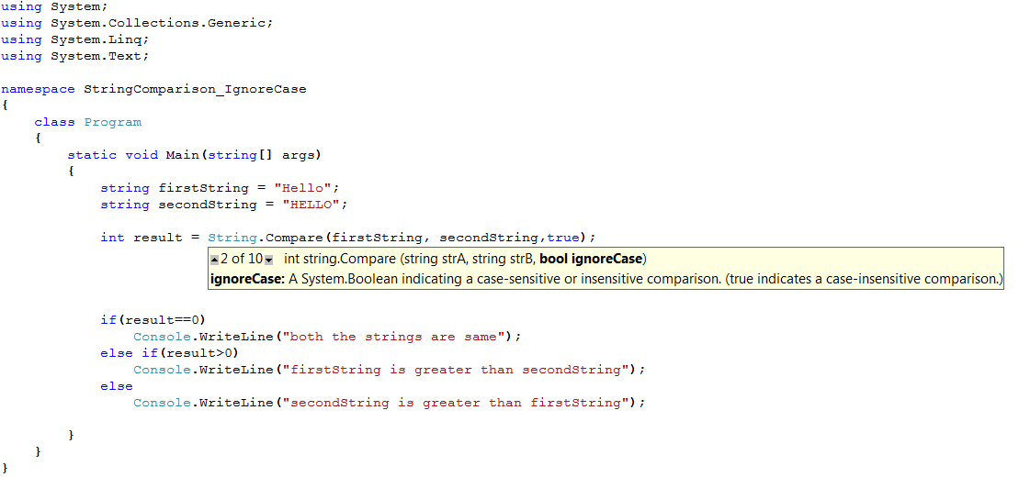
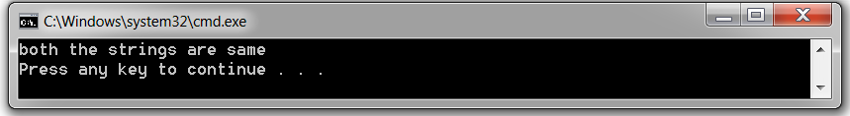
String Comparison (ignoring case sensitivity) Example
Unlike previous example this time case-sensitivity has been ignored by using another overloaded version of Compare method

Slide 92
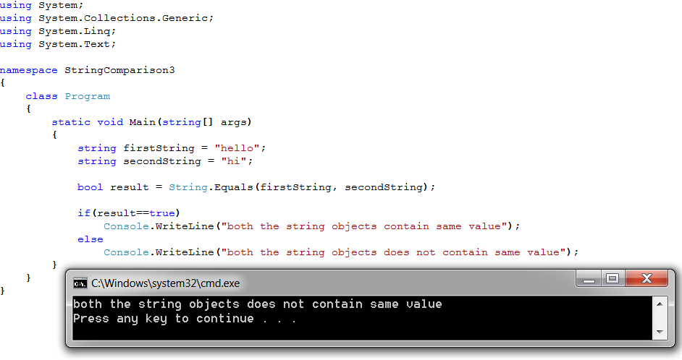
String Comparison using Equals method
Equals method String class: Determines whether two specified System.String objects have the same value.
public static bool Equals(string a, string b)
Returns:
true if the value of a is the same as the value of b; otherwise, false.

Slide 93
Empty and null string
String.Empty: To represent empty string String class has a field.
public static readonly string Empty
Represents the empty string. This field is read-only.
For example,
String str = String.Empty;
String variable can hold ‘null’ reference, too.
For example,
String str = null;
That means, this ‘str’ does not hold any reference of any string object.

Slide 94
Other Members of String class
Member | What it does
public string Substring(int startIndex, int length) | Retrieves a substring from this instance. The substring starts at a specified character position and has a specified length
public char[] ToCharArray() | Copies the characters in this instance to a Unicode character array
public string Trim(params char[] trimChars) | Removes all leading and trailing occurrences of a set of characters specified in an array from the current System.String object.
public char this[int index] { get; } | Gets the character at a specified character position in the current System.String object.
public string ToLower() | Returns a copy of this System.String converted to lowercase, using the casing rules of the current culture.
public string ToUpper() | Returns a copy of this System.String converted to uppercase, using the casing rules of the current culture.

Slide 95
Other Members of String class
Member | What it does
public string Replace(char oldChar, char newChar) | Replaces all occurrences of a specified Unicode character in this instance with another specified Unicode character.
public string Remove(int startIndex, int count) | Deletes a specified number of characters from this instance beginning at a specified position.
public string[] Split(params char[] separator) | Returns a string array that contains the substrings in this instance that are delimited by elements of a specified Unicode character array.
public static string Join(string separator, string[] value) | Concatenates a specified separator System.String between each element of a specified System.String array, yielding a single concatenated string.
public static string Concat(string str0, string str1) | Concatenates two specified instances of System.String.

Slide 96
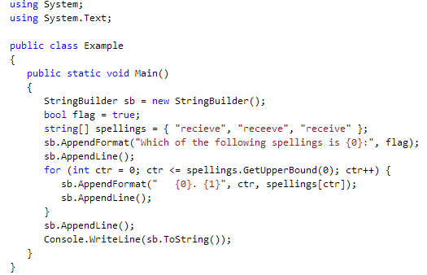
StringBuilder class
The String object is immutable. Every time you use one of the methods in the System.String class, you create a new string object in memory, which requires a new allocation of space for that new object.
In situations where you need to perform repeated modifications to a string, the overhead associated with creating a new String object can be costly.
The System.Text.StringBuilder class can be used when you want to modify a string without creating a new object.
For example, using the StringBuilder class can boost performance when concatenating many strings together in a loop.
Converting a StringBuilder Object to a String

Slide 97
Programming Guidelines
Identifiers are case-sensitive
The following rules apply:
They must begin with a letter or underscore, although they can contain numeric characters.
You can't use C# keywords as identifiers.
Naming conventions are to be followed while naming the Identifiers
Camel casing
Pascal casing
Notes:
Identifiers are the names you give to variables, to user-defined types such as classes and structs, and to members of these types.
Identifiers are case-sensitive, so for example variables named interestRate and InterestRate would be recognized as different variables. Following are a couple of rules determining what identifiers you can use in C#:
They must begin with a letter or underscore, although they can contain numeric characters.
You can't use C# keywords as identifiers.
Naming conventions
One important aspect to making your programs understandable is how you choose to name your items — and that includes naming variables, methods, classes, enumerations, and namespaces.
It is a Common sense that your names should reflect the purpose of the item and should be designed not to clash with other names. The general philosophy in the .NET Framework is also that the name of a variable should reflect the purpose of that variable instance and not the data type. For example, height is a good name for a variable, whereas integerValue isn't.
However, you will probably feel that that principle is an ideal that is hard to achieve. Particularly when you are dealing with controls, in most cases, you'll probably feel happier sticking with variable names like confirmationDialog and chooseEmployeeListBox, which do indicate the data type in the name.
Casing of names
In many cases you should use Pascal casing for names. Pascal casing means that the first letter of each word in a name is capitalized: EmployeeSalary, ConfirmationDialog, PlainTextEncoding. You will notice that essentially all of the names of namespaces, classes, and members in the base classes follow Pascal casing. In particular, the convention of joining words using the underscore character is discouraged. So you should try not to use names like employee_salary. It has also been common in other languages to use all capitals for names of constants. This is not advised in C#, because such names are harder to read — the convention is to use Pascal casing throughout:
const int MaximumLength;
The only other casing scheme that you are advised to use is camel casing. Camel casing is similar to Pascal casing, except that the first letter of the first word in the name is not capitalized: employeeSalary, confirmationDialog, plainTextEncoding. Following are three situations in which you are advised to use camel casing:
For names of all private member fields in types:
public int subscriberID; Note, however, that often it is conventional to prefix names of member fields with an underscore:
public int subscriberID;
For names of all parameters passed to methods:
public void RecordSale(string salesmanName, int quantity);
To distinguish items that would otherwise have the same name. A common example is when a property wraps around a field:
private string employeeName; public string EmployeeName { get { return employeeName; } }
If you are doing this, you should always use camel casing for the private member and Pascal casing for the public or protected member, so that other classes that use your code see only names in Pascal case(except for parameter names).

Slide 98
Programming Guidelines
For easy Reading and Writing data, Properties should be used.
Write only properties are not recommended.
If a value needs to be changed periodically, then use Methods to manipulate it.
Follow PASCAL Casing for Properties and methods that are public
Fields should almost always be private, except that in some cases it may be acceptable for constant or read-only fields to be public.
HINT: A very good way to get an intuitive feel for the conventions to follow when writing .NET code is to simply look at the base classes — see how classes, members, and namespaces are named, and how the class hierarchy works.
Notes:
Use of properties and methods
One area that can cause confusion in a class is whether a particular quantity should be represented by a property or a method. The rules here are not hard and fast, but in general, you ought to use a property if something really should look and feel like a variable. This means, among other things, that:
Client code should be able to read its value. Write-only properties are not recommended, so for example use a SetPassword() method, not a write-only Password property.
Reading the value should not take too long. The fact that something is a property usually suggests that reading it will be relatively quick.
Reading the value should not have any observable and unexpected side effect. Further, setting the value of a property should not have any side effect that is not directly related to the property. Setting the width of a dialog box has the obvious effect of changing the appearance of the dialog box on the screen. That's fine, as that's obviously related to the property in question.
It should be possible to set properties in any order. In particular, it is not good practice when setting a property to throw an exception because another related property has not yet been set. For example, if in order to use a class that accesses a database you need to set ConnectionString, UserName, and Password, then the author of the class should make sure the class is implemented so the user really can set them in any order.
Successive reads of a property should give the same result.
If the value of a property is likely to change unpredictably, you should code it up as a method instead. Speed, in a class that monitors the motion of an automobile, is not a good candidate for a property. Use a GetSpeed() method here; on the other hand, Weight and EngineSize are good candidates for properties because they will not change for a given object.
It's also worth bearing in mind that Microsoft has been fairly careful about being consistent and has followed its own guidelines when writing the .NET base classes. So a very good way to get an intuitive feel for the conventions to follow when writing .NET code is to simply look at the base classes — see how classes, members, and namespaces are named, and how the class hierarchy works. If you try to write your code in the same style as the base classes, you shouldn't go wrong.

Slide 99
Reference
For further details on any topic from C# language Fundamentals please visit http://msdn.microsoft.com/library and type search word in ‘Search Box’ and you will get relevant topics on that.
For difference between String and StringBuilder class
http://www.codeproject.com/Articles/6771/String-Vs-StringBuilder-C
For data types in C#
http://www.tutorialspoint.com/csharp/csharp_data_types.htm
For boxing and unboxing in C#
http://www.codeproject.com/Articles/2225/Boxing-and-unboxing-in-C
Notes:
Reference

